Slide 1
© 2018 Cengage Learning®. May not be scanned, copied or duplicated, or posted to a publicly accessible website, in whole or in part.

Slide 2
Customer Satisfaction and Customer Relationships
14
© 2018 Cengage Learning.® May not be scanned, copied or duplicated, or posted to a publicly accessible website, in whole or in part.

Slide 3
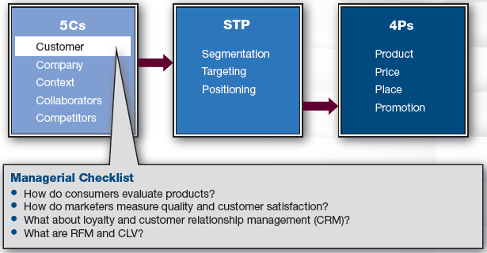
Marketing Framework

Slide 4
Discussion Questions #1
Does customer satisfaction matter? Why or why not?
How do you determine whether you are satisfied?

Slide 5
Customer Evaluations (slide 1 of 3)
Customer evaluations include
Customer satisfaction
Perceptions of quality
Customers’ intentions to repurchase
Customers’ likelihood of word-of-mouth, etc.
Marketers track these evaluations because they impact the bottom line

Slide 6
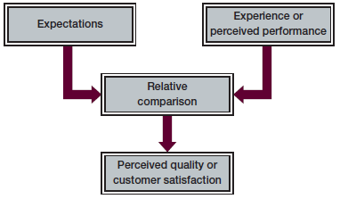
Customer Evaluations (slide 2 of 3)
Customer Evaluations = Experience − Expectations

Slide 7
Evaluation Outcomes
If customers’ experiences
Surpass their expectations→ delighted
Meet their expectations→ satisfied
Fall short of their expectations→ dissatisfied
Low-involvement purchases
Evaluation is instantaneous
Expectations are usually latent
Higher-involvement purchases
Evaluation is deliberative and conscious

Slide 8
Customer Evaluations (slide 3 of 3)
Search goods
Evaluate obvious qualities; straightforward
Experiential purchases
Evaluate after trial/consumption
Expectations might not be fully formed; the experience shapes evaluation & expectations
Credence purchases
Don’t have expertise to evaluate
Evaluate what one can (price, looks, etc.)

Slide 9
Sources of Expectations
Personal experience
Consumers trust their own experience
Experience can be direct or indirect
Friends and experts
Trust those with no commercial gain
Marketing mix elements
Ads, price, retail atmosphere, etc.
Third-party communications
e.g., Consumer Reports, books, and Internet

Slide 10
Expectation and Experience
The core (hygiene factors) and peripheral components (motivating factors) of a product both contribute to satisfaction
If the core is good, it doesn’t enhance satisfaction much because it is expected to be good
If the core is bad, it can affect dissatisfaction
Peripheral services can affect both

Slide 11
Expectation & Experience: Flowcharts
Marketers create flowcharts that map all of the interactions between the customer and company
From the eyes of the customer
Flowcharts are used to
Generate quality measures at each stage
Identify points of repeated problems
Suggest system redesigns to improve efficiency

Slide 12
Types of Expectations
Ideal levels of quality
Predicted levels of quality
Adequate levels of quality
Zone of tolerance exists between the adequate and predicted levels of quality

Slide 13
Customer Value
Value
The trade-off of the quality of the purchase received compared to the price paid and other costs incurred
Marketers try to increase perceptions of value

Slide 14
Expectations
Expectations are dynamic
What pleased a customer last time may no longer suffice
Expectations vary cross-culturally
In individualist cultures, satisfaction is heavily influenced by quality of reliability and service provider responsiveness
In collectivistic cultures, satisfaction is heavily influenced by the relational aspects of frontline employees

Slide 15
Measurement
Measuring quality with precision is difficult
Customer perceptions can be measured with surveys
Compare results to previous or competitive benchmarks
Surveys that measure multiple facets of customers’ thoughts are more actionable

Slide 16
Customer Dissatisfaction
The primary means to regain a dissatisfied customer is through empowered frontline employees
Immediately redress the problem
Empathize with customer
Offer a perk for customer’s troubles

Slide 17
Customer Relationship Marketing (slide 1 of 2)
Customer satisfaction is first step in long-term relationship
Loyalty programs
Price discounts may keep customers from defecting while inducing additional purchasing
Some companies may assume loyal customers are price insensitive and charge them more

Slide 18
Customer Relationship Marketing (slide 2 of 2)
CRM programs track customer information including RFM information
Recency, frequency, and monetary values of customers’ purchase history
These factors are used to “score” customers to identify the most desirable customers

Slide 19
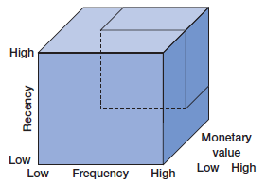
Discussion Question #2
Describe the most desirable customers according to the figure.

Slide 20
Customer Database Information
Contact information
Demographics
Lifestyle and psychographic data
Internet info
Transaction data (RFM, etc.)
Rate of response to marketing offers
Complaints

Slide 21
CRM
CRM programs
Take planning and money
Require ongoing customer monitoring
Companies struggle to design an information system with desired qualities
Integrate inputs from all relevant customer touch points
Access information in useful formats for managerial usage

Slide 22
Customer Lifetime Value (slide 1 of 2)
Companies utilize customer lifetime value (CLV) to assess customers in terms of their worth to the company
Some customers are costly to acquire, others more costly to retain

Slide 23
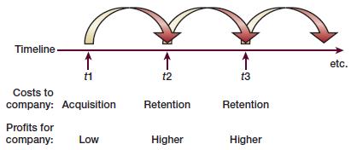
Customer Lifetime Value (slide 2 of 2)

Slide 24
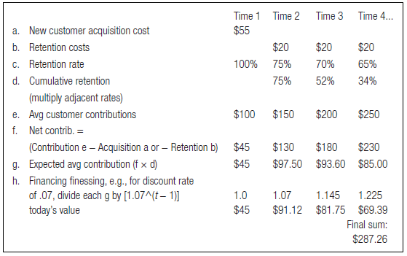
Customer Lifetime Value Example

Slide 25
Managerial Recap (slide 1 of 2)
Quality and customer satisfaction can be precisely measured for goods, but not as easily for services
Surveys can be used to ask customers for their evaluations of any purchase
Marketers care about loyalty and customer relationship management

Slide 26
Managerial Recap (slide 2 of 2)
Customer lifetime value is a means of translating marketing efforts into financial results
CLV allows firms to match customer benefits to revenues to ensure that each customer relationship remains profitable

